Slide 1

Airline Call Center Analysis: Understanding Customer Sentiment and Call Duration
This presentation analyzes data from an airline's call center, exploring customer sentiment, call duration, and agent behavior. The analysis aims to identify key trends and provide insights for improving customer experience and call efficiency.
By Vishnu Bansal and Arshit Verma
(PUNJAB ENGINEERING COLLEGE)

Slide 2

Reducing Call Time and Silence
United Airlines aims to improve customer satisfaction by decreasing average handle time (AHT) and average silence time (AST) at their call center. This analysis will explore factors influencing call duration and agent-customer engagement to identify opportunities for enhancement.

Slide 3

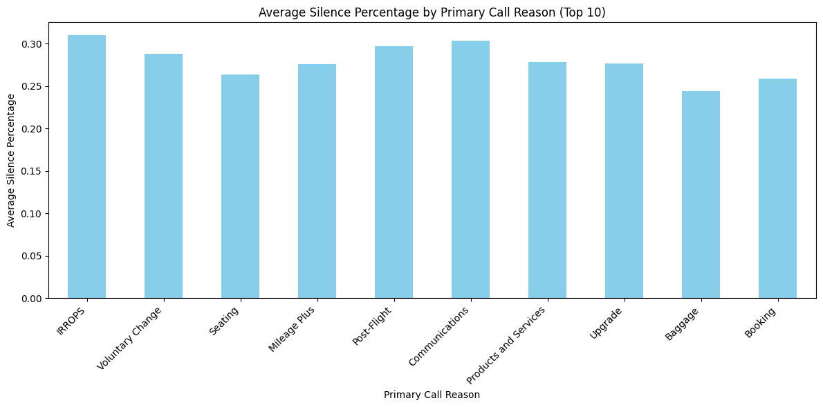
Average Silence Percentage by Call Reason
IRROPS and Communicatios
Seating and Baggage
High silence in IRROPS calls, indicating complex cases.
Lower silence in Seating and Baggage calls, indicating simpler interactions.
Long silences increase AHT, delaying resolutions.
Reflects efficient processes and well-trained agents.
Improve training and systems for faster info retrieval.
Maintain positive trend with ongoing training on policies.
Recommendation: Use a knowledge base for quick answers.
Emphasize clear communication and quick resolutions.
Goal: Boost efficiency and reduce call duration.
Goal: Sustain high customer satisfaction.
Voluntary Change and Upgrade
Booking and Post-Flight
High silence due to detailed procedures and decision-making.
Lower silence in Booking calls, indicating quick resolutions.
Goal: Reduce silence and improve overall efficiency.
Opportunity to simplify processes for changes and upgrades.
Streamline procedures for Post-Flight and Mileage Plus interactions.
Focus on training for concise communication and process optimization.
Mid-range silence in Post-Flight and Mileage Plus calls due to follow-ups.
Provide streamlined tools to help agents manage these requests efficiently.
Train agents on handling complaints and providing clear info on guidelines.
Goal: Minimize silence and expedite request handling.

Slide 4
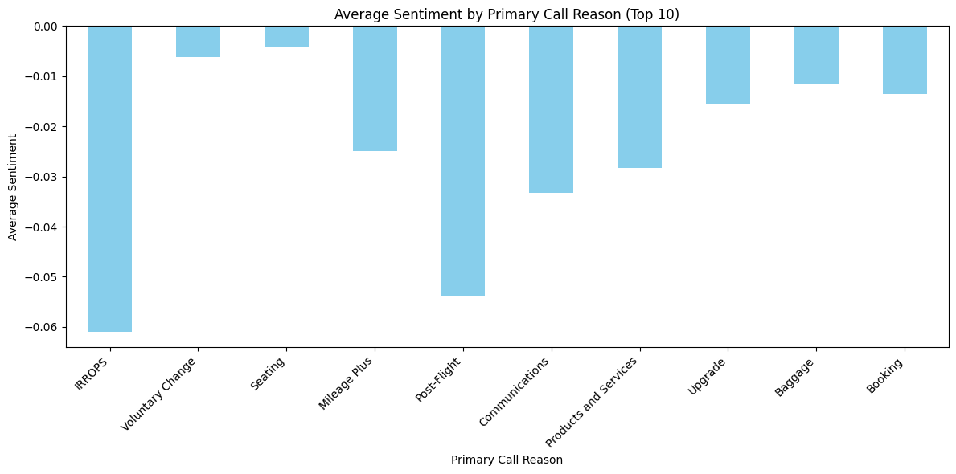
Average Sentiment by Call Reason
Negative Sentiment
All call reasons have negative sentiment, indicating overall dissatisfaction.
IRROPS
Most negative sentiment, suggesting customer dissatisfaction with disruptions.
This may result in higher average handle time (AHT) as agents struggle to address customer concerns and resolve issues.
Training agents in handling emotionally charged calls effectively could be beneficial, and exploring ways to use Interactive Voice Response (IVR) systems to resolve such issues before an agent is involved may also be effective.
Communications
Least negative sentiment, suggesting less frustration with communication issues.
Booking
Still reflects some level of dissatisfaction, despite being less negative than other categories.
Post-Flight and Mileage Plus
Significant negative sentiment due to baggage and loyalty program issues.
These categories may also contribute to higher AHT as agents spend more time addressing complex issues.
Providing agents with additional training on handling complaints and program guidelines effectively, along with improving the IVR system to address common issues, might be key to minimizing the impact of negative sentiment on call duration.
Other Categories
Moderately negative sentiment, indicating frustration with issues like voluntary changes, seating, products and services, upgrades, and baggage.

Slide 5

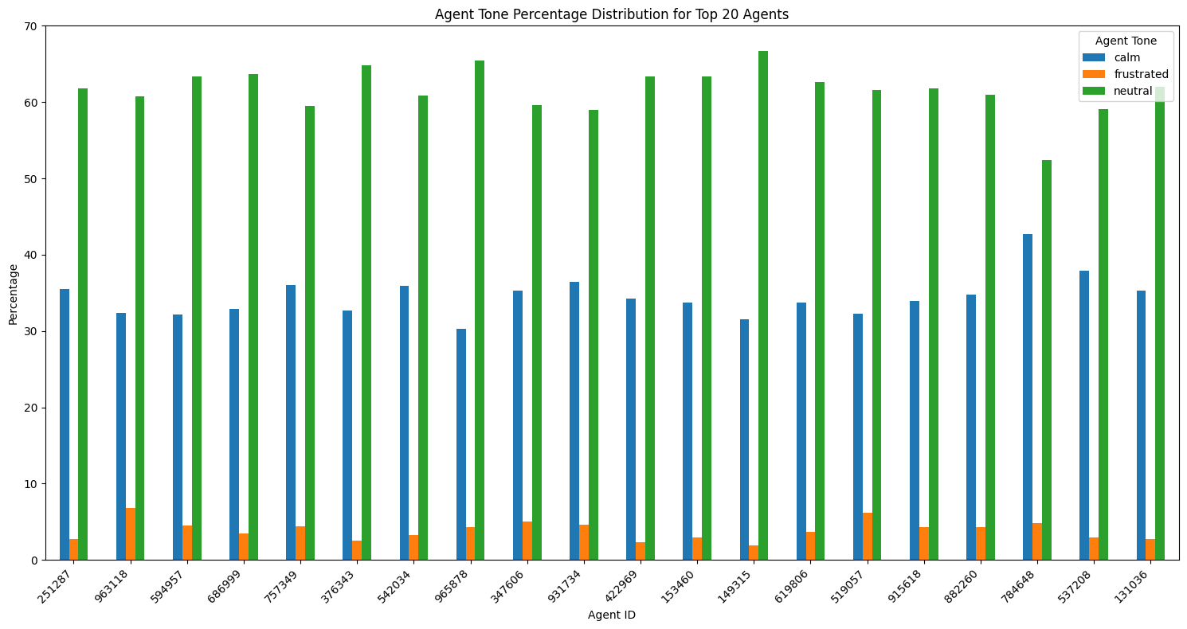


Agent Tone Analysis
Calm Tone
Higher Calm Tone observed in IRROPS, Post-Flight, and Baggage calls.
Indicates a need for reassurance in high-stress situations such as flight disruptions and baggage issues.
Calm tone helps reduce AHT by promoting smoother, more controlled conversations.
Agent training should focus on maintaining a calm demeanor during emotionally
charged or complex scenarios.
Benefits: Enhanced customer satisfaction and improved call handling efficiency.
Neutral Tone
Dominant across categories, suggesting agents handle calls objectively.
Frustrated Tone
Minimal frustration tone observed across all call categories, indicating agents’
strong emotional control.
Low frustration levels are a positive indicator of smooth customer-agent interactions.
Training recommendation: Teach agents to recognize potential frustration triggers in challenging calls.
Goal: Further minimize frustration by preemptively managing difficult conversations.
Outcome: Smoother interactions and potentially shorter call durations, improving overall efficiency.

Slide 6
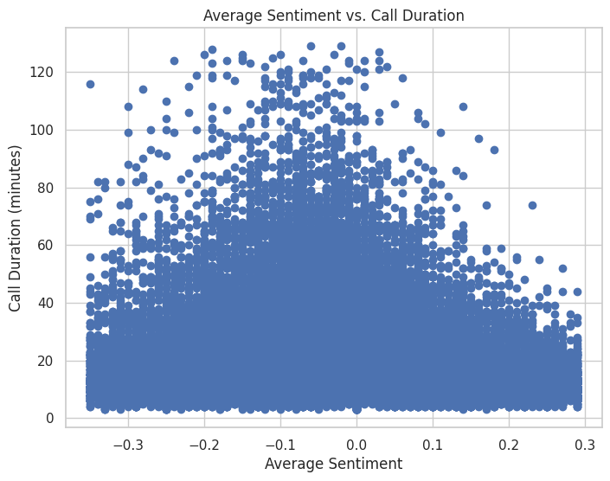
Call Duration and Sentiment Analysis
1
Neutral Sentiment
Calls with neutral sentiment are more likely to have ‘
longer durations, indicating balanced and engaging conversations.
2
Negative Sentiment
Negative sentiment calls tend to cluster at shorter durations, potentially indicating unresolved issues or a lack of engagement. This highlights the importance of training agents to effectively handle customer frustration and implement improved call scripts for addressing negative sentiment.
3
Positive Sentiment
Positive sentiment calls do not necessarily have shorter durations, but tend to follow a similar pattern to neutral calls. This suggests that positive sentiment, while contributing to a more pleasant experience, may not always translate into faster call resolution.

Slide 7
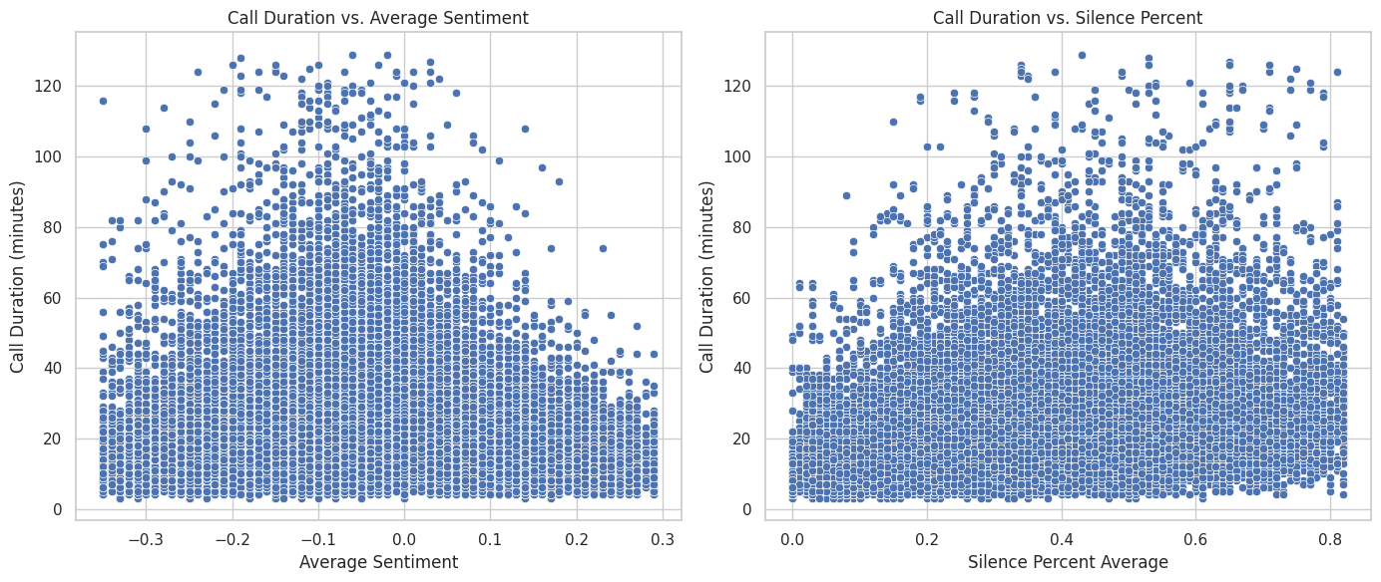
Call Duration, Sentiment, and Silence Analysis
Longer Calls
Shorter Calls
Longer calls are associated with neutral-to-positive sentiment and lower silence percentages, suggesting more engaged and balanced conversations.
Shorter calls are more likely to have negative sentiment or higher silence percentages, indicating less engaging or difficult conversations.

Slide 8
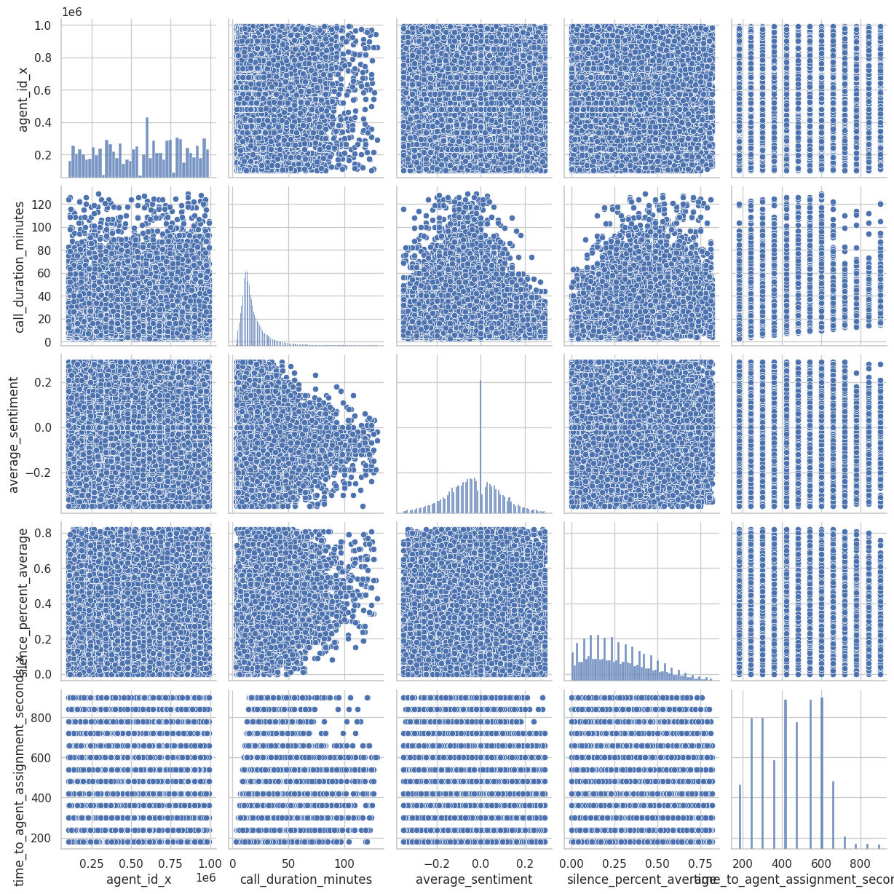
Pair Plot Analysis: Key Findings
20
Shorter Calls
Calls under 20 minutes show a wide range of sentiment.
60
Neutral Sentiment
Neutral sentiment is prevalent across all call lengths, especially between 20 and 60 minutes.
60+
Longer Calls
Calls over 60 minutes tend to have more balanced sentiments.

Slide 9
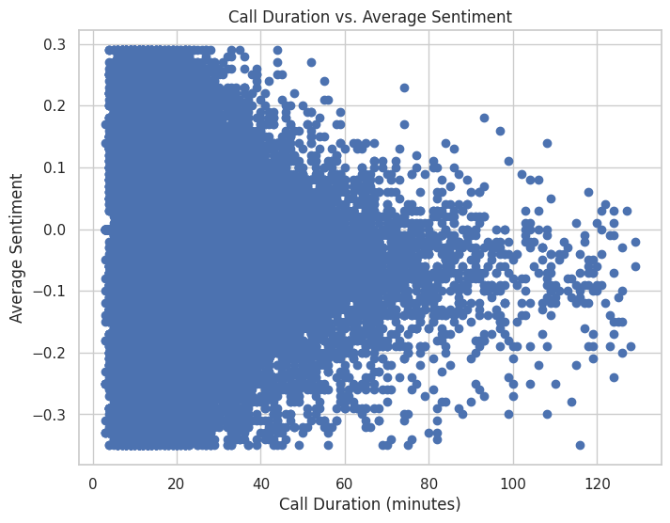
Call Duration and Engagement
1
Sentiment Impact
Call duration is influenced by sentiment, with neutral and positive tones leading to longer discussions.
2
Silence's Role
More active conversations (less silence) correlate with longer calls.
3
Engagement's Influence
Higher engagement and interaction generally result in longer call durations.

Slide 10
Reducing Call Time and Silence: Improving IVR and Call Routing
Average Silence Time (AST):
Delays in agent availability and inefficient call routing significantly contribute to high AST.
High AST leads to frustrating experiences for customers.
Opportunities for Improvement:
Enhancing the Interactive Voice Response (IVR) system and call routing algorithms can help reduce wait times.
Improvements can guide customers to the appropriate agents more quickly.
AI-Powered IVR Enhancements:
Implementing AI-powered IVR can streamline initial customer interactions.
Provides more intuitive self-service options and better context-aware routing.
Real-Time Data Integration:
Integrating real-time data on agent availability and call volumes can optimize call distribution.
Ensures customers reach the best-suited agent promptly.

Slide 11
Improving Call Efficiency and Customer Experience
Optimize IVR for Common Requests: Enhance the Interactive Voice Response system to provide better self-service options and intelligent routing, reducing wait times and directing customers to the appropriate agents.
Specialized Training for Emotional Calls: Implement targeted training for agents on managing customer emotions, employing calming techniques, and resolving frustrations, especially for IRROPS-related calls.
Streamline Call Routing and Visibility: Integrate real-time data on agent availability and call volumes to optimize call distribution, ensuring customers reach the best-suited agent promptly.
Automate Simple Requests: Leverage AI-powered chatbots and virtual assistants to handle straightforward customer inquiries, allowing agents to focus on more complex and emotional interactions.
Enhance Agent Engagement: Encourage agents to actively listen, empathize, and build rapport with customers, fostering stronger relationships and more satisfying experiences.

Slide 12



Key Findings and Recommendations
IRROPS and Post-Flight
These call types are associated with higher silence percentages. Consider updating scripts and providing agents with specific training on handling these calls to reduce unproductive silence and optimize call handling.
1
Agent Training
2
Focus on managing emotions, calming elements, and reducing frustration. This can significantly reduce the negative sentiment observed in shorter calls, leading to more constructive and efficient conversations.
Engagement and Sentiment
Our analysis shows that longer calls with neutral-to-positive sentiment and lower silence percentages correlate with greater customer satisfaction. Encourage agents to engage customers proactively and build rapport to foster positive interactions and extend call durations.
3

Slide 13
Conclusion
Key Insights
Actionable Insights
Future Research
The analysis highlights factors influencing call duration, customer sentiment, and agent behavior. Key findings include the significant role of silence and customer emotions in call length, as well as the correlation between engagement and longer conversations with positive sentiment.
Targeted training programs for agents can lead to significant improvements in customer experience and call efficiency. By focusing on reducing silence in calls related to Irregular Operations (IRROPS) and post-flight issues, agents can become more efficient and improve customer satisfaction. Additionally, training agents to handle negative emotions and navigate challenging conversations can lead to faster and more constructive call resolutions.
Further research can explore strategies for enhancing customer interactions and call efficiency, specifically exploring the effectiveness of improved self-service options in the IVR and proactive customer communication to address potential issues before they escalate into calls.

Slide 14

Thank You
We appreciate your time and interest!

